Slide 1



LISTENING TO RECOVERY
Where Tone meets Transformation.
ABHIROOP K | ALINA H | KEERTI R |
MANORANJITH A | ROHAN D | SIMONI D

Slide 2

Navigating the uncertain path to addiction recovery
Current Problems
Scattered Information
Limited Accessibility
Scale of the Crisis
No data-driven way to understand recovery journey
What challenges should I expect at different stages?
Empowering Informed Decisions
When do most people experience setbacks?
Setting Realistic Expectations
What strategies have worked for others?
Supporting Healthcare providers
Reducing Isolation
What will my journey actually look like?
Our
Approach
Collect real audio narratives of addiction recovery stories*
Analyze key recovery stages and emotional patterns
Map each individual’s journey from beginning to end
Transform human stories into data-driven insights on recovery trends
*Scraped transcripts of 51 videos from ‘Texas Picture Documentaries’ (YouTube)

Slide 3




From unstructured stories to structured insight
Mapping emotional and behavioral recovery patterns using AI
1
9 Journey stages identified
NOT ALL JOURNEYS
ARE LINEAR
Background
First Use
Escalation
Rock Bottom
Turning Point
Treatment
Early Recovery
Relapse
Maintenance
2
GPT-4o-mini for Stage Detection
Understanding patterns help
predict challenges
3
Validated with direct quotes
4
AI UNCOVERS
HIDDEN PARALLELS
Pattern Recognition across stories
AI can uncover common triggers
and recovery patterns shared
across individual journeys

Slide 4

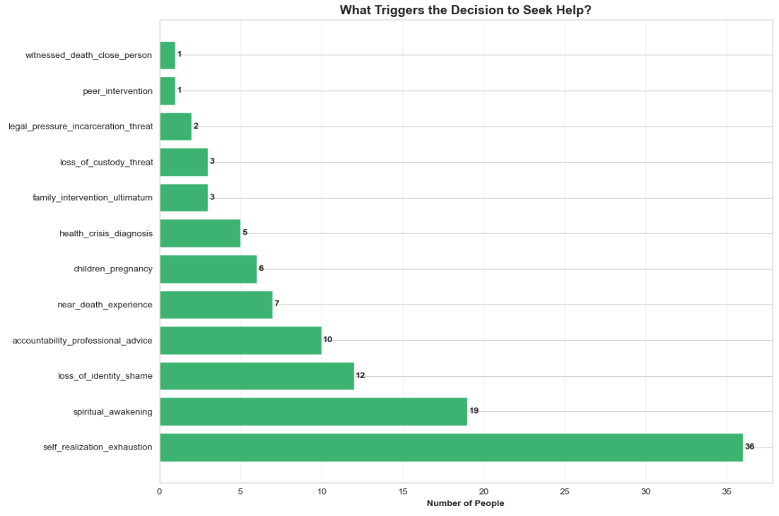

Self-realization is the strongest?!
What really drives recovery?
Internal motivation beats external pressure
Top 4 triggers are ALL internal/personal
70% cite self-realization as their turning point
COUNTER- INTUITIVE FINDINGS!
Family pressure triggers recovery in only 6%
Internal motivation outpaces external pressure 12×
For treatment programs: Design interventions that facilitate self-reflection
For families: Support the person’s journey toward self-awareness rather than trying to force change

Slide 5
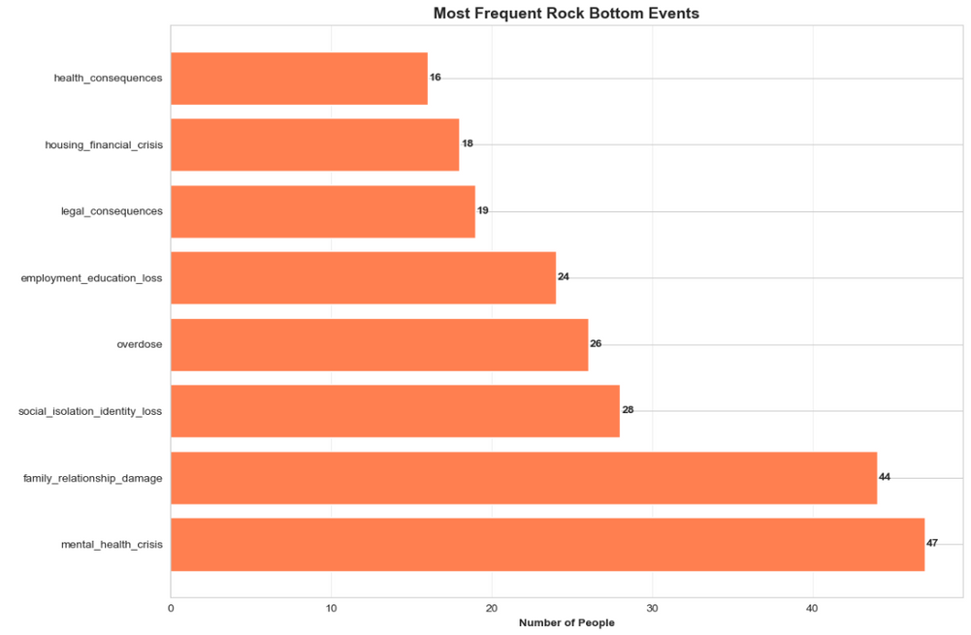
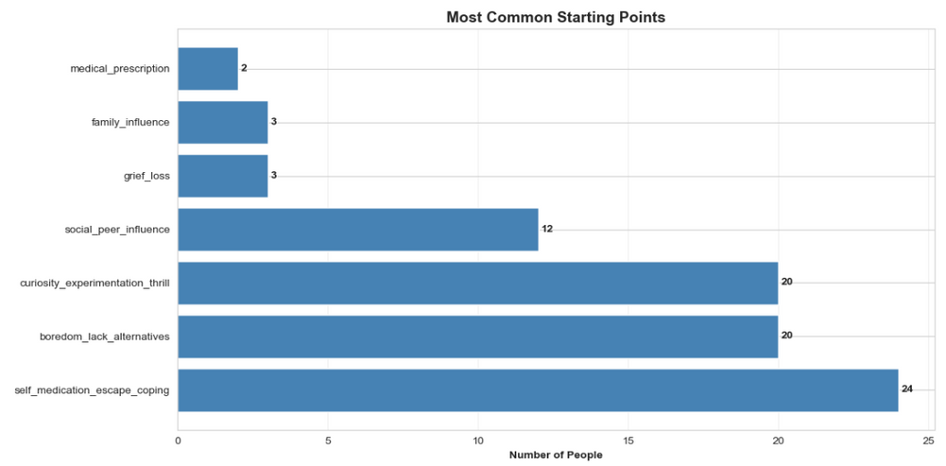

Most frequent rock bottom events
Common starting points
The triad of destruction: Mental Health (47) + Family Damage (44) + Social Isolation (28) = The Core Crisis
The self-medication pathway → 47% started with self-medication
Self-medication
Loss of control
Mental health crisis
Key Insights
Mental health crisis in 92% → Addiction is a mental health condition
Family relationships fail in 86% → Social pain > physical pain
Physical health consequences rank LAST! → not the root cause
Clinical Implications
Treat mental health FIRST
Family therapy is critical
Key Insights
47% began with self-medication, not recreation
Boredom and purposelessness drive 39% of first use
Medical prescriptions trigger <5% - challenges the “opioid crisis started with doctors” narrative for this sample
Clinical Implications
Address boredom and purpose, not just drugs
Build coping skills before crisis

Slide 6
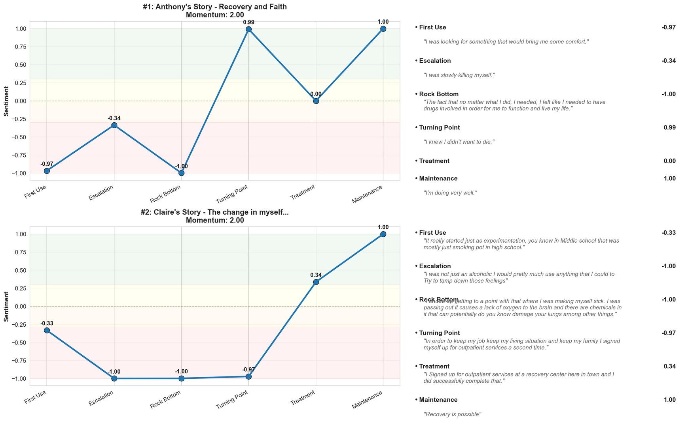


Why sentiment analysis wasn’t sufficient!
Sentiment models misread emotional language - optimism can appear early, and crisis can sound calm
We used DistilBERT to analyze sentiment across journey stages, but found it overly sensitive to language nuances rather than actual recovery progress, leading us to develop a more robust rule-based severity metric.
Sentiment captures emotion, but true recovery needs more context-aware metrics.
Positive language doesn’t equal recovery progress early stages may still sound hopeful
Context matters! “I said ENOUGH” reads as positive to the model, when it’s slightly a moment of crisis
Recovery is non-linear. The erratic patterns do capture one truth - recovery isn’t a straight line.
SENTIMENT
RECOVERY
Top 2 stories with highest recovery momentum

Slide 7
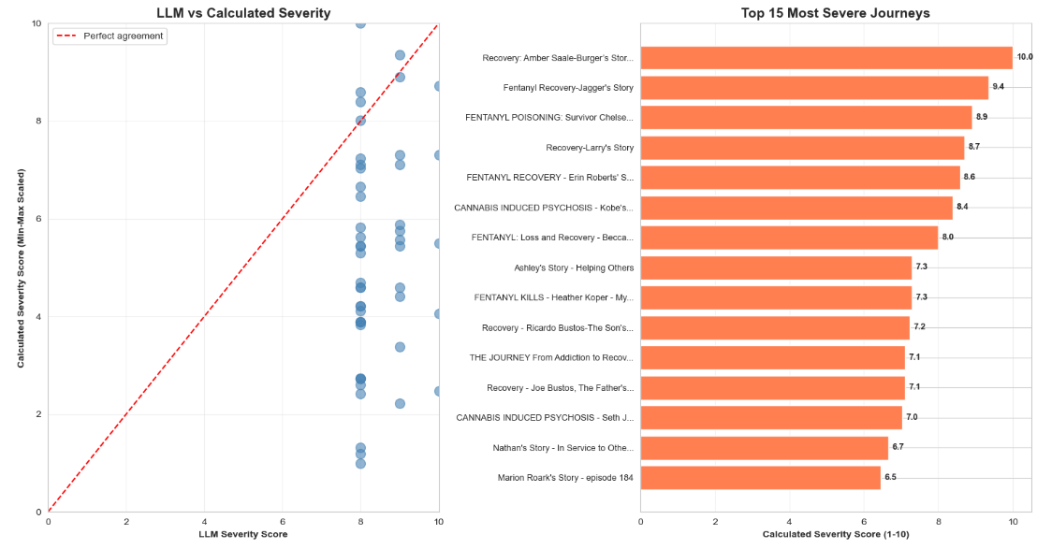
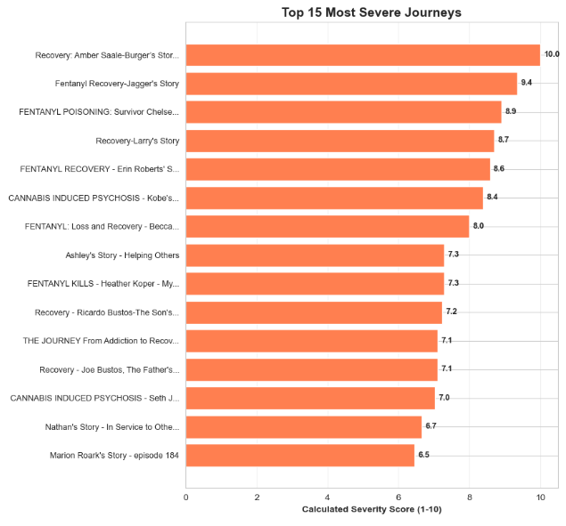



Beyond Sentiment: An Event Driven Severity Score
Fentanyl crisis pattern
5 / 15 most severe journeys involve fentanyl
Worst Rock Bottom!
Amber’s Journey
Severity: 10/10
# of Events: 7
Challenge
Our Approach
LLM scores showed ceiling effect - most stories rated 8-10
Limited ability to distinguish severity levels, e.g., moderate vs. extreme crises
Create rule-based scoring using:
Weighted events by clinical severity
# of events (repeated trauma matters!)
Multiple crisis types (mental health + legal + housing) compound severity
SEVERITY =
Weighted Events x Frequency Multiplier + Diversity Bonus

Slide 8

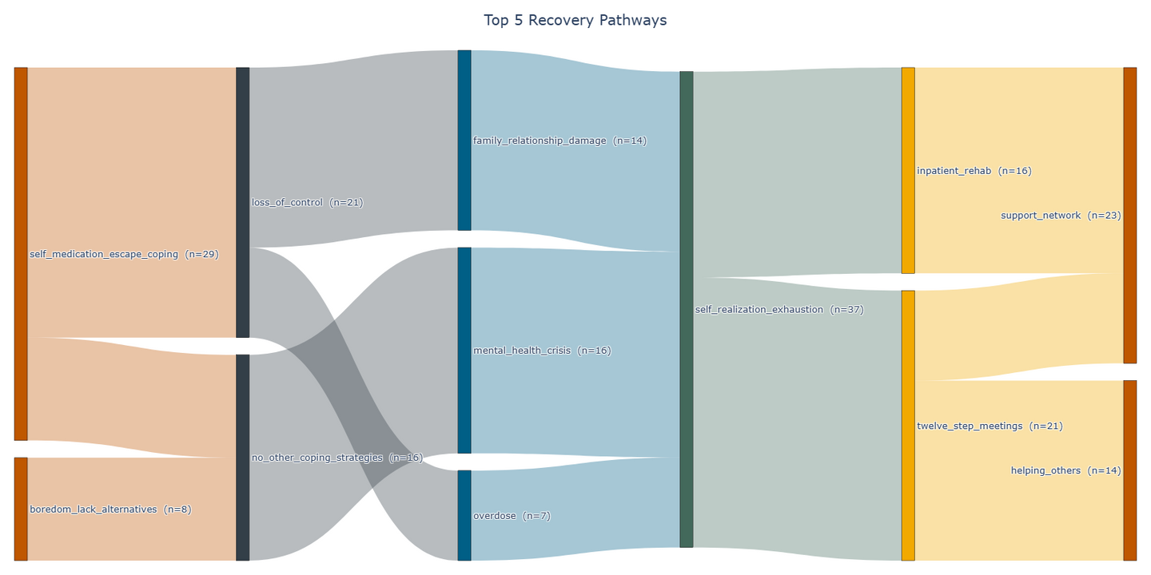
The Path to Recovery: Different Journeys, Shared Patterns
Patterns that repeat across stories reveal the formula behind recovery
We mapped each person’s full journey - from first use to maintenance - to uncover the most frequent and successful pathways. These routes reveal what truly helps people recover, guiding more effective recovery interventions.
Recovery is personal, but patterns repeat.
Recognizing them can save lives.
First Use
Escalation
Rock Bottom
Turning Point
Maintenance
Family relationship damage
Recovery patterns discovered:
Turning Point: Self-realization > external help
Treatment: Structured inpatient programs + peer support work best
Maintenance: Community and ongoing meetings keep recovery alive
Inpatient rehab
Loss of control
Support network
Self medication
Self realization and exhaustion
Mental health crisis
Twelve step meetings
No other coping strategies
Helping others
boredom (lack of alternatives)
Overdose
Sankey Diagram: Top 5 Recovery Pathways

Slide 9


Interactive Recovery Dashboards
Build clinician-facing visual tools that allow dynamic filtering by addiction type, demographics, or treatment success rate.
Expand Dataset Diversity
Include multilingual and cross-cultural narratives to generalize findings beyond English-speaking recovery communities.
Temporal Modeling
Introduce sequence models (like LSTMs or Transformers) to predict relapse likelihood or next probable stage in the journey.
Context-aware Sentiment Models
Fine-tune emotion detection models on addiction-specific language to avoid false positives/negatives.
FUTURE SCOPE & IMPROVEMENTS
Integrate Speech & Tone Analysis
Extend from text to audio emotion — analyzing tone, pauses, and stress markers for deeper empathy mapping.
Real-Time Tracking & Early Intervention System
Build a system that continuously analyzes new journal or voice inputs to detect early signs of relapse and provide timely intervention.

Slide 10

Thank you!
Any thoughts?
10

